Slide 1
Digital Certificate

Slide 2
Digital Certificate
It is also known as a public key certificate
It is used to cryptographically link ownership of a public key with the entity that owns it
Digital certificates are for sharing public keys to be used for encryption and authentication

Slide 3
Digital Certificate
Digital certificates
include the public key being certified,
identifying information about the entity that owns the public key,
metadata relating to the digital certificate and
a digital signature of the public key the certificate issuer created.
The distribution, authentication and revocation of digital certificates are the primary functions of the PKI, the system that distributes and authenticates public keys.

Slide 4
Digital Certificate
Public key cryptography depends on key pairs:
one private key to be held by the owner and used for signing and decrypting and
one public key that can be used for encrypting data sent to the public key owner or authenticating the certificate holder's signed data.
The digital certificate enables entities to share their public key so it can be authenticated.

Slide 5
Digital Certificate
A digital certificate contains the following identifiable information:
The name of the user
The department or company to which the user belongs
The internet protocol (IP) address or serial number associated with the device
A copy of the public key obtained from a certificate holder
The period during which the certificate will be valid
The domain that the certificate is authorized to represent

Slide 6
Digital Certificate
Digital certificates are
used in public key cryptography functions most commonly for initializing SSL connections between web browsers and web servers.
also used for sharing keys used for public key encryption and authentication of digital signatures
Digital certificates that are supported by mobile operating environments, laptops, tablet computers, IoT devices, and networking and software applications help protect websites, wireless networks and virtual private networks

Slide 7
How are digital certificates used?
Digital certificates are used in the following ways:
Credit and debit cards
use chip-embedded digital certificates that connect with merchants and banks
to ensure that the transactions performed are secure and authentic.
Digital payment companies
to authenticate their automated teller machines and point-of-sale equipment in the field with a central server in their data center

Slide 8
How are digital certificates used?
Websites use digital certificates for domain validation to show they are trusted and authentic
Secure email
to identify one user to another and may also be used for electronic document signing.
The sender digitally signs the email, and the recipient verifies the signature.
Computer hardware manufacturers embed digital certificates into cable modems to help prevent the theft of broadband service through device cloning

Slide 9
Why digital certificates used?
As cyber threats increase,
more companies are considering attaching digital certificates to all of the IoT devices that operate at the edge and within their enterprises
The goals are to prevent cyber threats and protect intellectual property.

Slide 10
Who can issue a digital certificate?
An entity
can create its own PKI and issue its own digital certificates, creating a self-signed certificate
This approach might be reasonable when an organization maintains its own PKI to issue certificates for its own internal use.
But certificate authorities (CAs)
considered trusted third parties in the context of a PKI issue digital certificates.
to issue digital certificates enables individuals to extend their trust in the CA to the digital certificates it issues.

Slide 11
Digital certificates vs. digital signatures
Public key cryptography supports several different functions, including
encryption and authentication, and
enables a digital signature.
Digital signatures are generated using algorithms for signing data so a recipient can irrefutably confirm the data was signed by a particular public key holder.

Slide 12
Digital certificates vs. digital signatures
Digital signatures
are generated by hashing the data to be signed with a one-way cryptographic hash;
the result is then encrypted with the signer's private key.
The digital signature incorporates this encrypted hash, which can only be authenticated, or verified, by using the sender's public key to decrypt the digital signature and then running the same one-way hashing algorithm on the content that was signed.
The two hashes are then compared.
If they match, it proves that the data was unchanged from when it was signed and that the sender is the owner of the public key pair used to sign it.

Slide 13
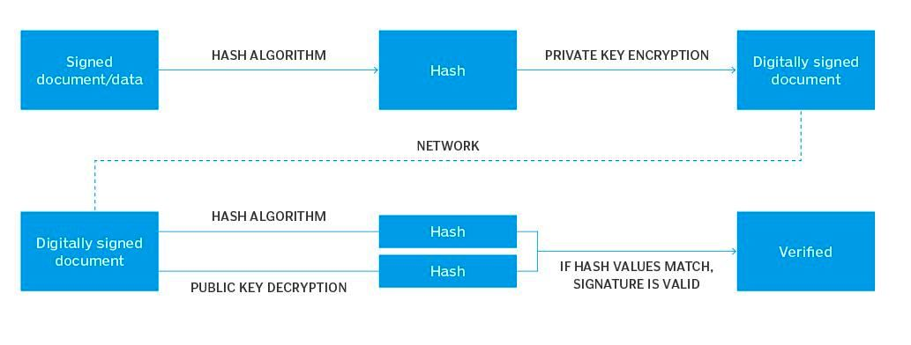
Digital certificates vs. digital signatures

Slide 14
Digital certificates vs. digital signatures
A digital signature can depend on the distribution of a public key in the form of a digital certificate,
but it is not mandatory that the public key be transmitted in that form.
However, digital certificates are signed digitally, and they should not be trusted unless the signature can be verified.

Slide 15
Types of digital certificates
Web servers and web browsers use digital certificates to authenticate over the internet.
These digital certificates are
used to link a web server for a domain to the individual or organization that owns the domain.
usually referred to as SSL certificates even though the Transport Layer
The three types are the following:
Domain-validated (DV) SSL
Organization-validated (OV) SSL
Extended validation (EV) SSL

Slide 16
Domain-validated (DV) SSL
DV SSL certificates
offer the least amount of assurance about the holder of the certificate
Applicants for DV SSL certificates need only demonstrate that they have the right to use the domain name
While these certificates can ensure the certificate holder is sending and receiving data,
they provide no guarantees about who that entity is.

Slide 17
Organization-validated (OV) SSL
OV SSL certificates
provide additional assurances about the certificate holder
They confirm that the applicant has the right to use the domain
OV SSL certificate applicants also undergo additional confirmation of their ownership of the domain

Slide 18
Extended validation (EV) SSL
EV SSL certificates
are issued only after the applicant proves their identity to the CA's satisfaction
The vetting process verifies the existence of the entity applying for the certificate,
ensures that identity matches official records and is authorized to use the domain, and
confirms that the domain owner has authorized issuance of the certificate.

Slide 19
Types of digital certificates
The exact methods and criteria CAs follow to provide these types of SSL certificates for web domains is evolving as the CA, industry adapts to new conditions and applications.
There are also other types of digital certificates used for different purposes:
Code signing certificates
Client certificates

Slide 20
Code signing certificates
Code signing certificates
may be issued to organizations or individuals who publish software.
These certificates are used to share public keys that sign software code, including patches and software updates.
Code signing certificates certify the authenticity of the signed code.

Slide 21
Client certificates
Client certificates
also called a digital ID,
are issued to individuals to bind their identity to the public key in the certificate
Individuals can use these certificates to digitally sign messages or other data
They can also use their private keys to encrypt data that recipients can decrypt using the public key in the client certificate.

Slide 22
Digital certificate benefits
Privacy
When you encrypt communications, digital certificates safeguard sensitive data and prevent the information from being seen by those unauthorized to view it.
This technology protects companies and individuals with large troves of sensitive data.
Ease of use
The digital certification process is largely automated.

Slide 23
Digital certificate benefits
Cost effectiveness
Compared to other forms of encryption and certification, digital certificates are cheaper.
Most digital certificates cost less than $100 annually.
Flexibility
Digital certificates do not have to be purchased from a CA.
For organizations that are interested in creating and maintaining their own internal pool of digital certificates, a do-it-yourself approach to digital certificate creation is feasible.

Slide 24
Digital certificate limitations
Security
Like any other security deterrent, digital certificates can be hacked.
The most logical way for a mass hack to occur is if the issuing digital CA is hacked
This gives bad actors an on-ramp into penetrating the repository of digital certificates the authority hosts.
Slow performance
It takes time to authenticate digital certificates and to encrypt and decrypt.
The wait time can be frustrating.

Slide 25
Digital certificate limitations
Integration
Digital certificates are not standalone technology
To be effective, they must be properly integrated with systems, data, applications, networks and hardware.
This is no small task.
Management
The more digital certificates a company uses, the greater the need to manage them and to track which ones are expiring and need to be renewed.
Third parties can provide these services, or companies can opt to do the job themselves.
But it can be expensive.

